Slide 1
Estimation of area for REDD+ using stratified sampling estimator
Rémi D’Annunzio
16-19 May 2017, Phnom Penh, Cambodia
remi.dannunzio@fao.org

Slide 2
Uncertainty in UNFCCC context
IPCC defines greenhouse gas (GHG) inventories consistent with “good practice” as those which “contain neither over-nor underestimates so far as can be judged, and in which uncertainties are reduced as far as practicable.”
In particular, information on uncertainty can be used to develop conservative REDD+ estimates, to ensure that reductions in emissions or increases in removals are not overestimated.
Source: GOFC-GOLD / WB FCPF training materials for REDD+ monitoring and reporting

Slide 3
Uncertainties in area changes
In REDD+ context, a Tier 3 estimate of area and/or area change typically results from analysis of a RS product
Maps only are subject to classification errors that induce bias into estimations and sampling only usually miss classes of interest
A suitable approach is to use the map as a stratification device and collect reference data from points to produce area estimates.

Slide 4
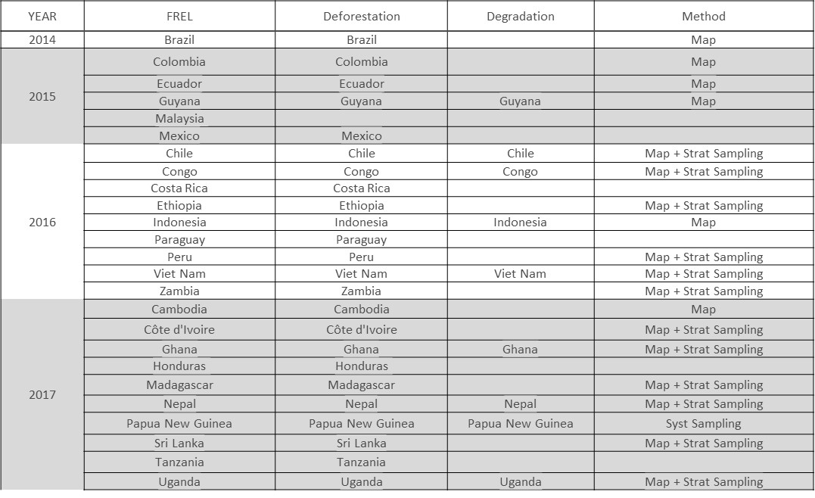
FREL submissions

Slide 5
Objectives
Understand how maps are used as stratification for area estimation
Design a SAE system (sampling + reference collection)
Create AA outputs (confusion matrix, adjusted estimates) and compare with other area estimations

Slide 6
Work plan
Day 1 Refresh on stratified sampling area estimation
Discussion FAO/WB/Donors on area estimation using maps
Review of national data, introduction to SEPAL
Creating a sampling design (hands on with SEPAL)
Day 2 R and GEE training
Obtaining data from GEE + Sentinel portals (hands on GEE)
Time series generation (hands on with R) / Collect Earth exercise
Day 3 Analysis of results
Confusion matrices, Stratified estimators (hands on with SEPAL)
Comparison with systematic sampling design results
Day 4 Evaluation + Discussion on further steps
Open session

Slide 7
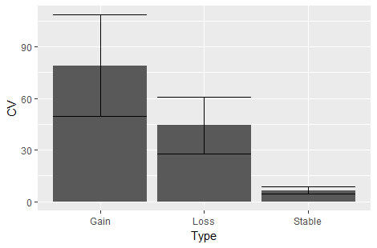
Meeting April 2017 in FAO Rome

Slide 8
Recommendations
In terms of area estimation and wording used
The principle purpose for collecting reference data is for area estimation.
We suggest not to include map estimates (pixel counts) in reports.
Include map accuracy figures as a separate section from parameter estimates
In terms of assessing the quality of results and usefulness of the method
Compute results from the sampling device as simple random
Compare the parameters obtained with simple VS stratified random sampling
In terms of response design for stratified area estimates:
No matter if the map is pixel-based or polygon-based : use point based interpretation
In terms of improvement of the method
Assess the effects of adding samples to reduce the effects of errors
Assess Effects of stratifying by error class
Notes:
In terms of area estimation and wording used
No longer use the term ‘Area Adjustment’ or ‘Adjusted Area’ and no emphasis on the term ‘Map Accuracy Assessment’. The principle purpose for collecting reference sample data is for stratified area estimation. The reference sample data are used to make the actual parameter estimates (e.g. area of deforestation) and the map is used primarily to stratify the area of interest to increase the precision of the parameter estimates. If map accuracy is really a concern (e.g. if concerns that a particular class is quite poorly mapped or we want to encourage the re-mapping of an AOI), we can still do that. But, in general, we want to stick with saying stratified area estimation.
We suggest that we DO NOT include map estimates (e.g. pixel counts) in reports. Rather we should ONLY include the area estimates after reference data collection and stratified area estimation.
Include map accuracy figures in reports only as necessary and as a separate section from parameter estimates (e.g. area of deforestation).
In terms of assessing the quality of results and usefulness of the method
We recommend to do a calculation in which the reference data collected is treated as a simple random sample and estimate parameters (e.g. area of deforestation) from the sample alone (e.g. without consideration of the map class from which it came).
Then, compare these parameter estimates obtained from the simple random sample against the parameter estimates obtained from the stratified random sample (e.g. those obtained using the map as the stratified). The confidence intervals obtained from the calculation using the map should be smaller than those considering only a simple random sample. If they are not, then the map is not really assisting us to estimate parameters.
In terms of sampling design for stratified area estimates:
No matter if the map is pixel-based, object-based or polygon-based - we now recommend that the sample unit is either a pixel or a 3x3 pixel block. This is simpler, easier to defend and easier to do the calculations. We can continue to use the image segments, polygons or surrounding information to support the reference classification, however.
In terms of improvement of the method
Assess the effects of adding samples to the stable class to reduce the effects of errors of change omission in stable classes
Look at the effects of stratifying by error class - e.g. uncertain forest v. certain forest v. loss in certain v. uncertain forest. In other words, are we mixing errors ?

Slide 9
Issues on maps for area estimation
All maps have errors (bias)
change maps have cumulated errors
we must account for these
Reference data are required
of higher quality than data used to make map;
can be ‘better’ data, or ‘better’ interpretation
Purpose is to generate new area estimates
based on the stratified sampling
which generate with confidence intervals

Slide 10
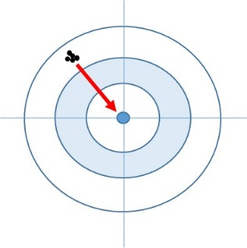
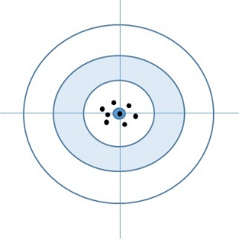
What type of errors in a map ?
Systematic error: accuracy
Random error: precision
The accuracy assessment aims at providing a measure of both

Slide 11
Issues with pure sampling approaches

Slide 12
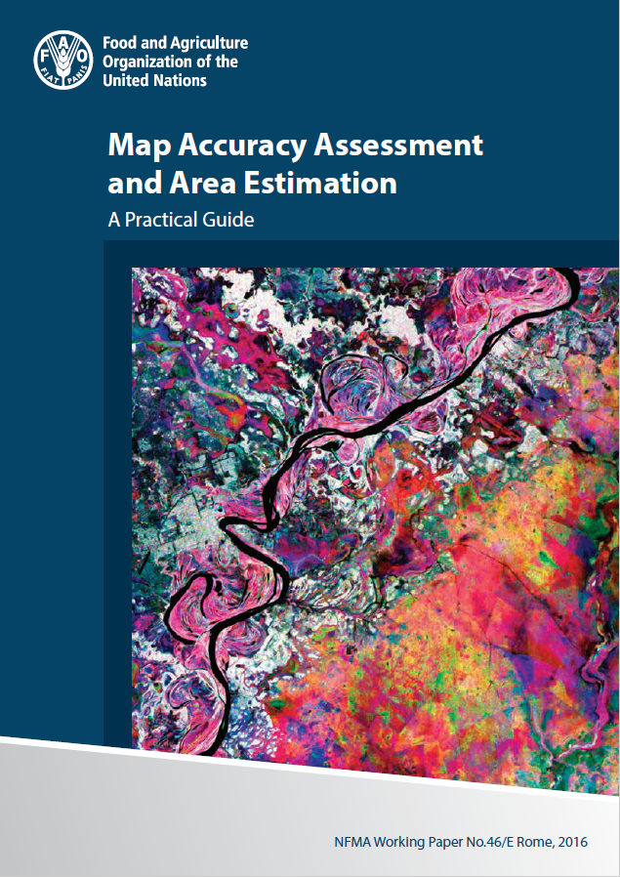
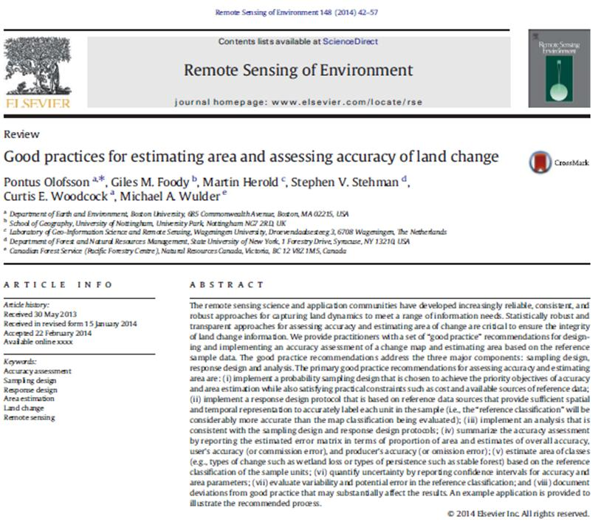
Good practices for assessing accuracy of land change
Notes:
The methods have existed since the 70s, this paper is a compilation of accepted methods. It is a practioners guide to AA and area estimation. Recommendations and examples for each step of the process: (I) sampling design, (II) response
design and (III) analysis; (IV) example provided to illustrate recommended workflow. Important to note they are recommendations: there are many options for customizing the steps, such as choosing the preferred sampling scheme (random, stratified random, systematic)

Slide 13
Steps of stratified area estimation
Finalized map data
Response design
Analysis
Sampling design

Slide 14
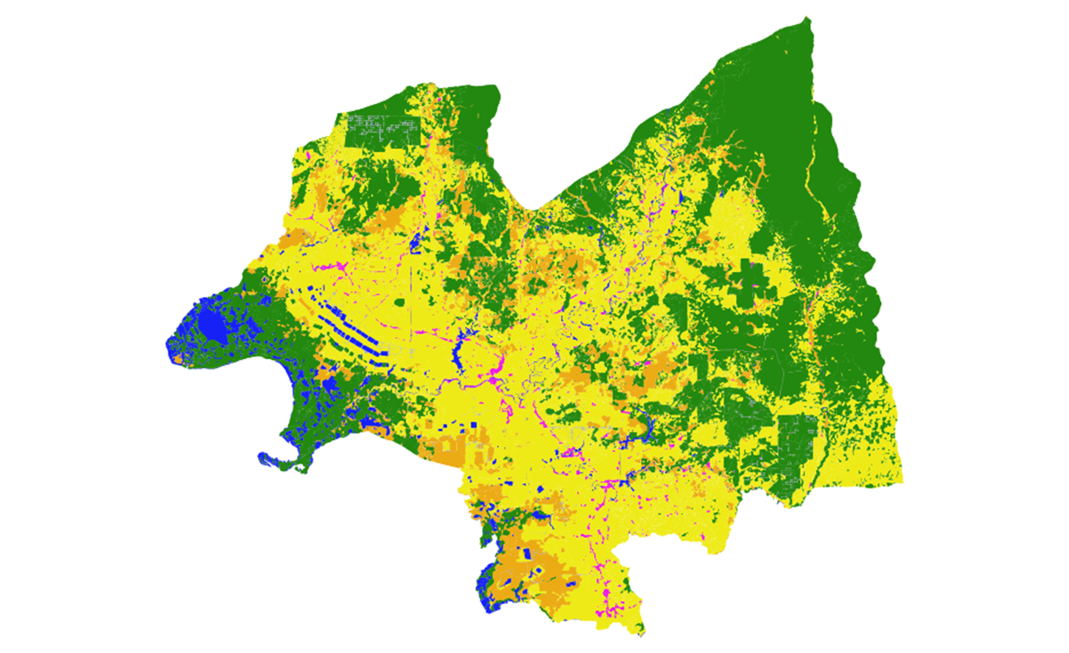
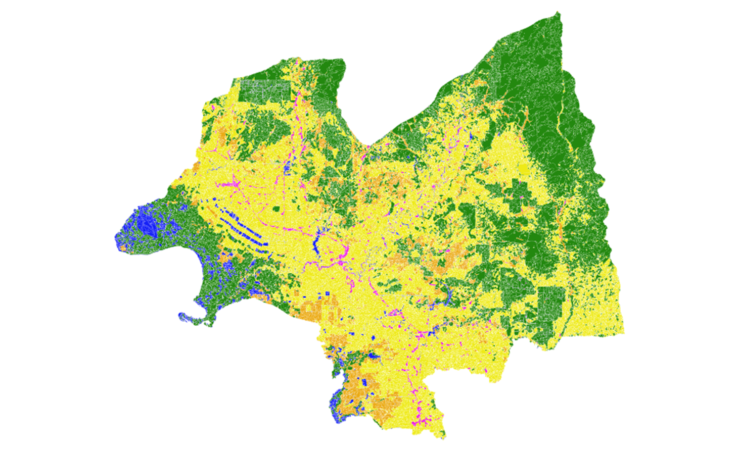
Land use change map to be assessed

Slide 15
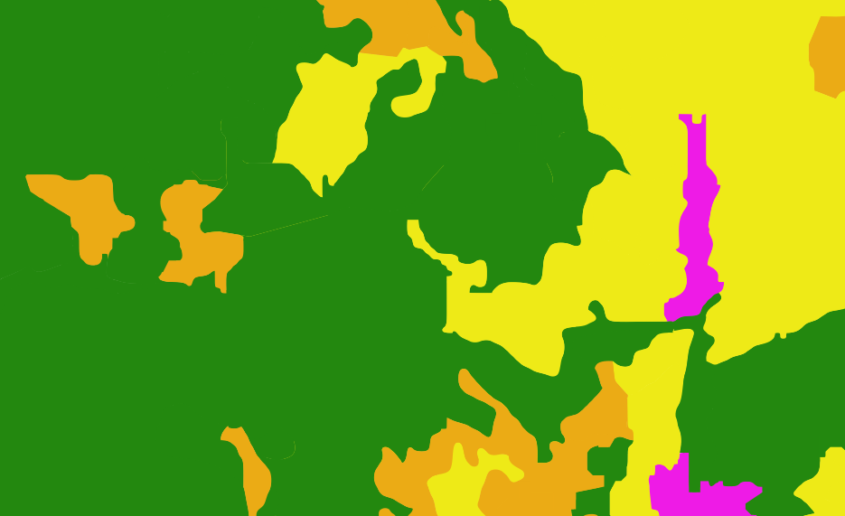
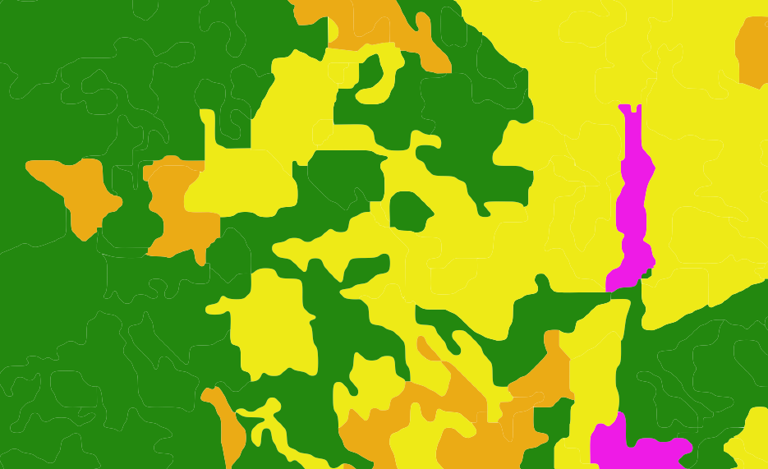
Change in code AND shape

Slide 16
Map categories, transition matrix (1000 ha)
95% of the area is STABLE (1,179 Mha out of 1,245 Mha

Slide 17
Steps of stratified area estimation
Finalized map data
Response design
Analysis
Sampling design

Slide 18
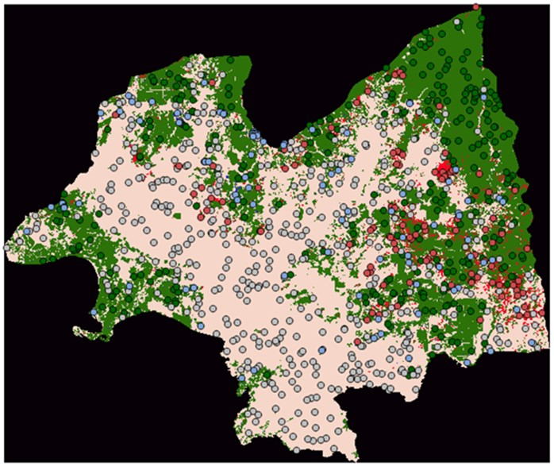
Sampling design
Notes:
Not possible to examine all the parts
Stratified random sampling recommended
Sample size can be calculated by formula

Slide 19
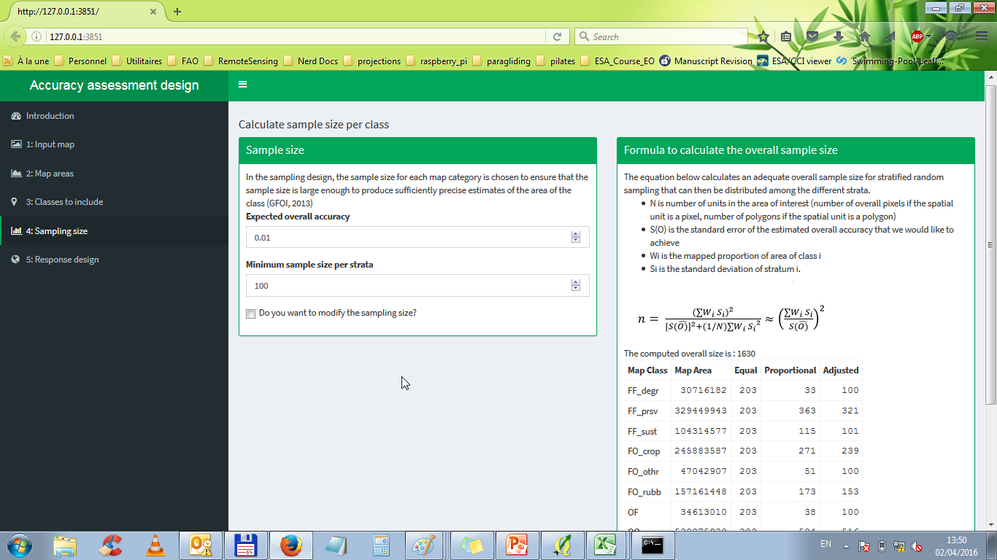
Sampling design: tool in https://sepal.io

Slide 20
Steps of stratified area estimation
Finalized map data
Response design
Analysis
Sampling design

Slide 21
Response design
The reference data MUST be of higher quality
Higher quality means higher spatial or radiometric resolution
Or the process to create the reference classification is more accurate, i.e. using a human to classify Landsat imagery rather than an algorithm
Should be from the same time period
Spatial assessment unit:
Points
Pixel
Polygon
Pixel block (aggregated pixels)
Sources of reference data
Google earth
National forest inventory

Slide 22
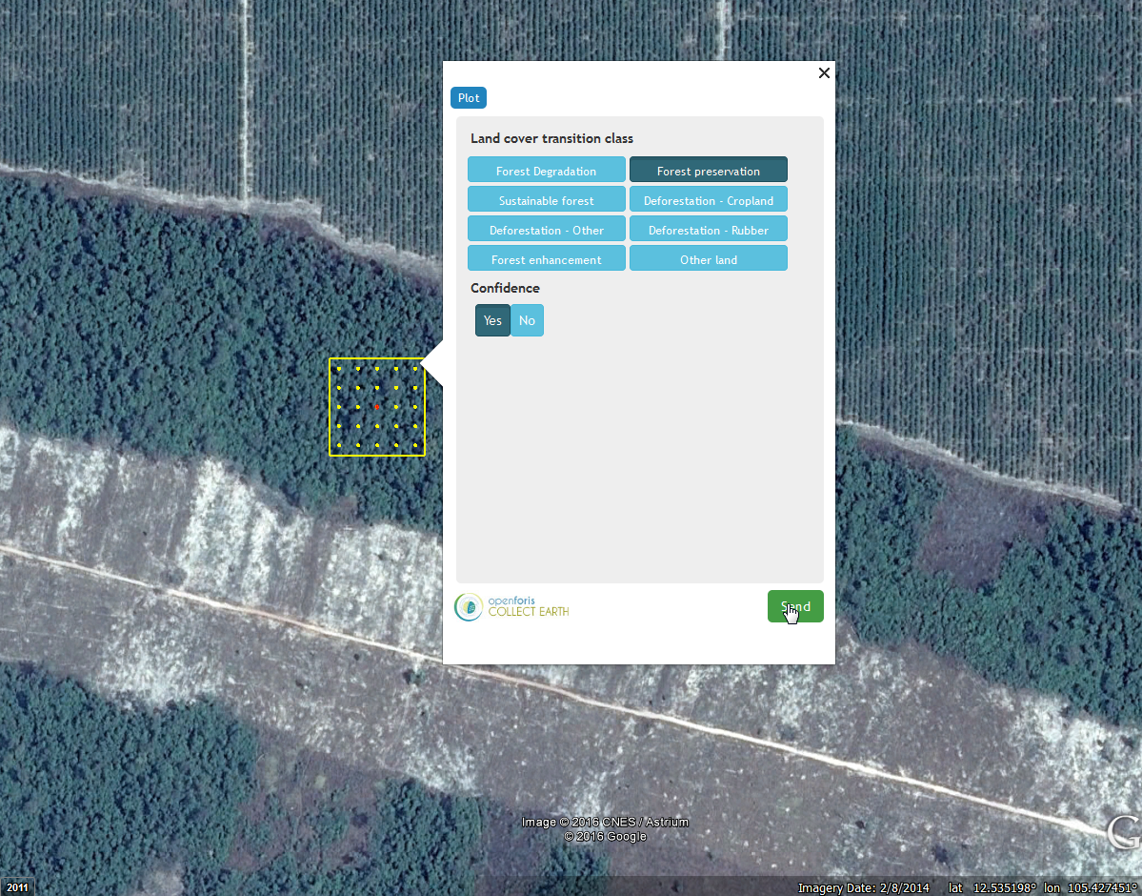
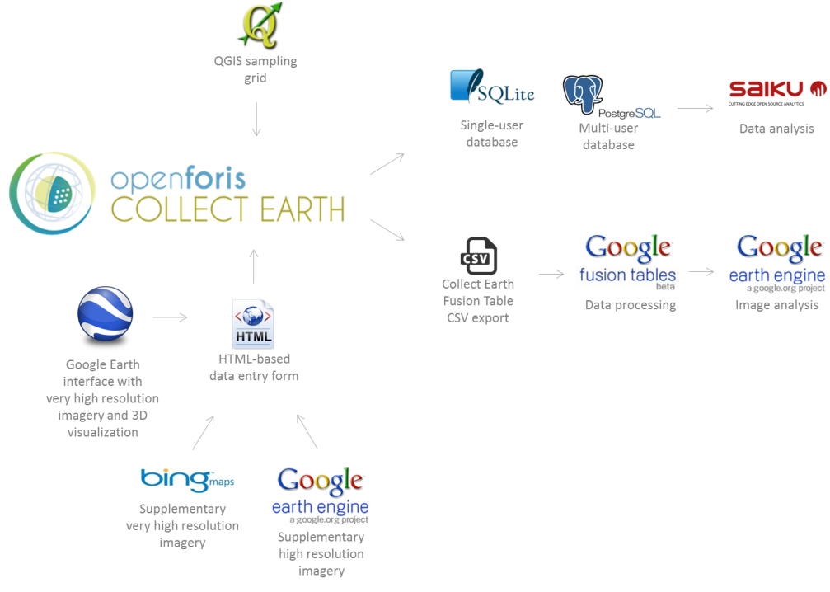
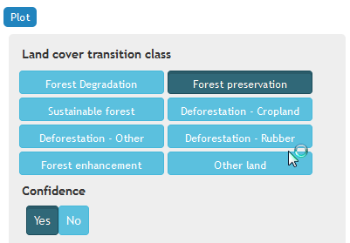
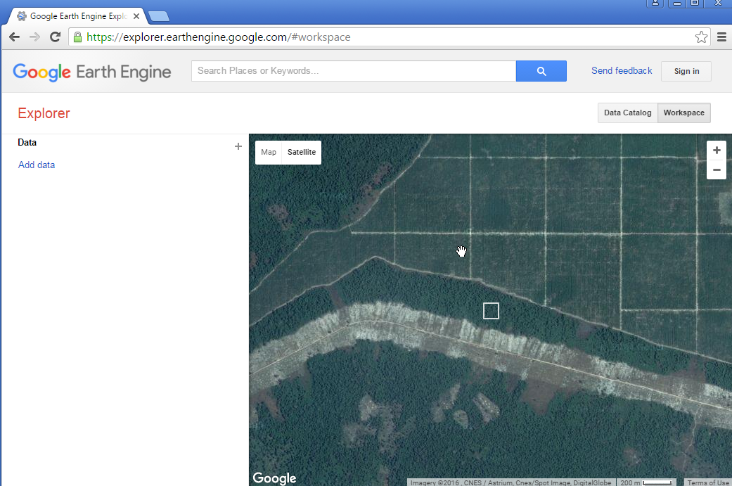
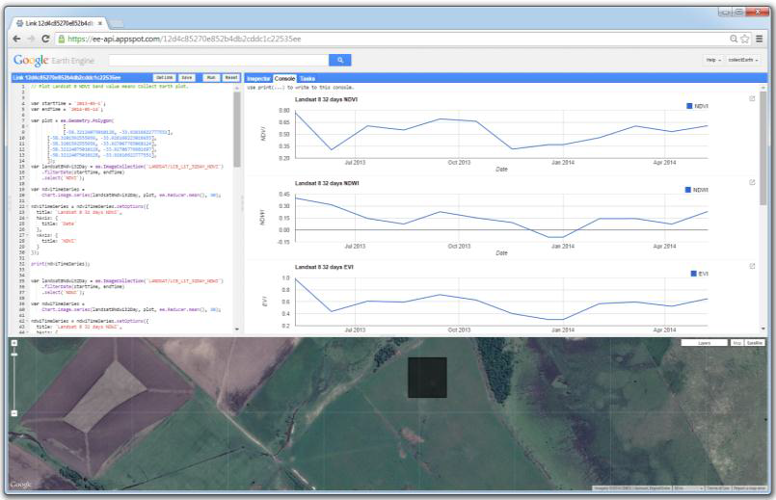
Response design: Collect Earth

Slide 23
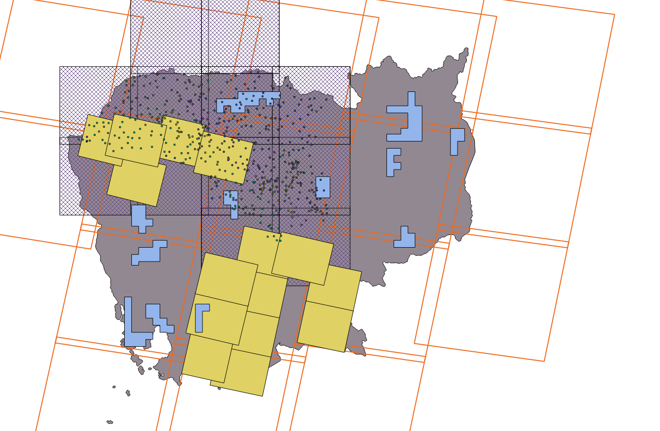
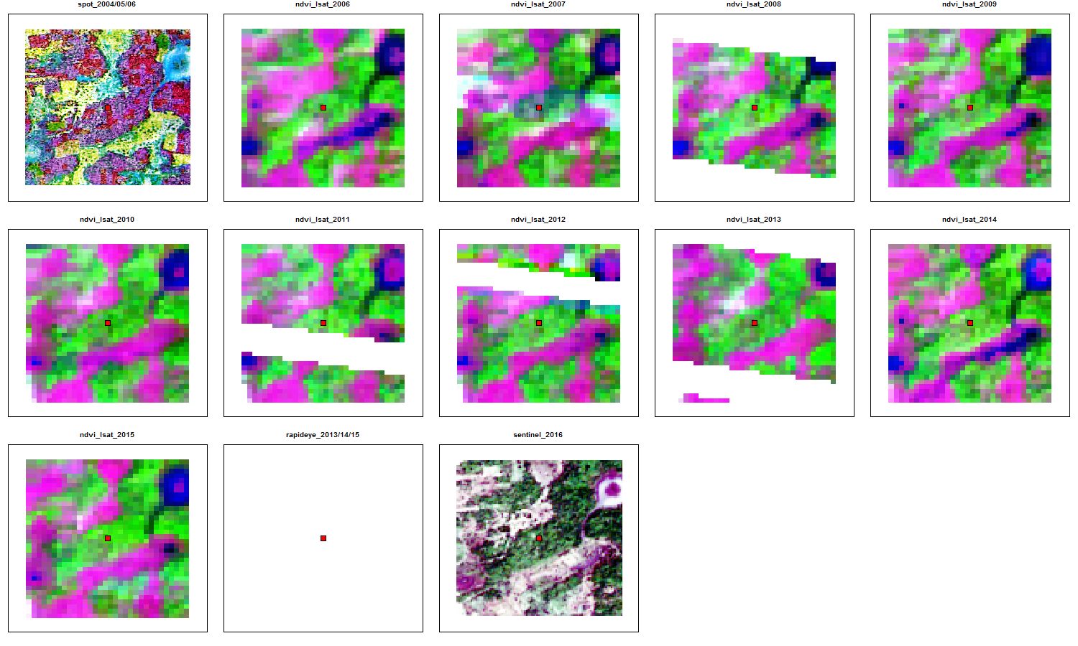
Response design: Other data sources
All Landsat from 2006 to 2015
SPOT from 2006 (brown)
RapidEye from 2014 (blue)
Sentinel 2 from 2016 (hashed)

Slide 24
Response design wrap up
Need to have clear understanding of the map classes
Need higher quality data
Reference labeling protocol
Establish rules for heterogeneous assessment units
Notes:
(show example in collect earth, for example if a sample plot is 50% water and 50% grassland, what should the user categorize this as?)

Slide 25
Steps of Accuracy Assessment
Finalized map data
Response design
Analysis
Sampling design

Slide 26
Analysis – Calculate accuracy statistics
Based on the proportional error matrix
Entire map
Overall accuracy with confidence interval
Per strata
User’s accuracy with confidence interval
Producer’s accuracy with confidence interval
Notes:
User’s accuracy is the proportion of the area classified as class i that is also class i in the reference data (see equation 3).
). It provides users with the probability that a particular area of the map of class i is also that class on the ground.

Slide 27
Take home messages
Need to assess accuracy of spatial data
Maps are not perfect
Extracting statistics from maps
Goal: Get adjusted area estimates of land cover classes
Clear guidance available
“Easy” to implement
Cost and time efficient

Slide 28




The tools: free and open-source solutions
https://sepal.io
www.r-project.org
Design and Analysis
www.gdal.org
www.shiny.rstudio.com
Response
www.openforis.org

Slide 29
Thank you!
Questions?

